Slide 1

AUDISANKARA COLLEGE OF ENGINEERING AND TECHNOLOGY
Department of
Electrical and Electronics Engineering
Technical Seminar on
SOCIAL DISTANCING TOOL USING ULTRASONIC SENSOR AND ARDUINO UNO
Presented by
19G21A0202
19G21A0219
19G21A0213
19G21A0215
20G25A0208

Slide 2
CONTENT
1.Introduction.
2.Overview.
3.Circuit Diagram.
4.Apparatus required.
5.Work Plan.
6.Software Required.
7.ARDUINO IDE.
8.Programming Languages Used.
9.Application.
10.Future Plan.
11.Conclusion.
12.References.

Slide 3
Introduction
Aims to decrease or interrupt transmission of COVID-19 in a population by minimizing contact between potentially infected individuals and healthy individuals, or between population groups with high rates of transmission and population groups with no or low levels of transmission.

Slide 4
Overview
Coronavirus disease (Covid-19) is an infectious disease that is caused by a newly discovered virus, known as the coronavirus that comes under the category of SARS.
It has been originated in Wuhan, China, and has spread across the whole world like the "fire in the forest".
Due to the increase in the pandemic day by day, the number of people infected by it is in the millions and the deaths are in lakhs. The transmission of the virus is through physical contact from person to person/objects and gets multiplied to pass to the community.
The technique which can help to reduce the virus is social distancing. This paper proposes a device that gives actual and real-time information observed by the device. It helps the person to remind of having social distancing. The hardware, run by the Arduino programmed software, is small and can be easily carried.

Slide 5
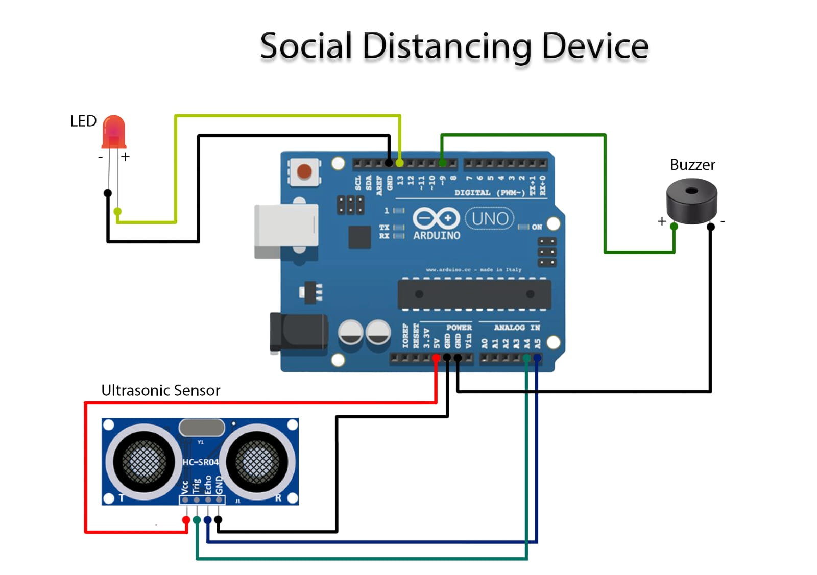
Circuit Diagram

Slide 6
Apparatus
Ultrasonic Sensor
Battery
Piezo Buzzer
Jumper wires
Microcontroller(Arduino uno)
LED

Slide 7
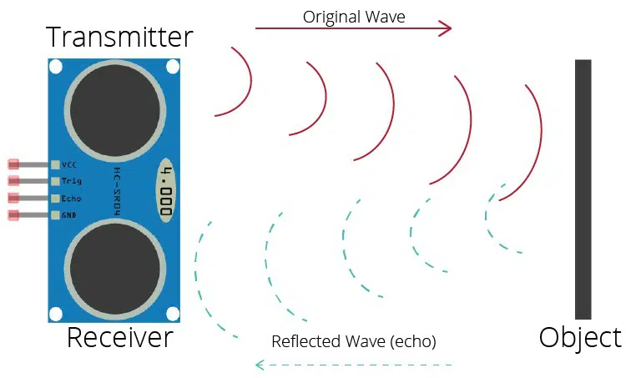
ULTRASONIC SENSOR

Slide 8
Ultrasonic Sensor
This device measures the distance of a target object by emitting ultrasonic sound waves, and converts the reflected sound into an electrical signal. Ultrasonic waves travel faster than the speed of audible sound.
Ultrasonic sensors have two main components:
1). Transmitter: Which emits the sound
Using piezoelectric crystals.
2). Receiver: Which encounters the sound after it has travelled to and from the target.
The sensor measures the time it takes between the emission of the sound by the transmitter to its contact with the receiver. The formula calculation is
D=1/2 T *C

Slide 9
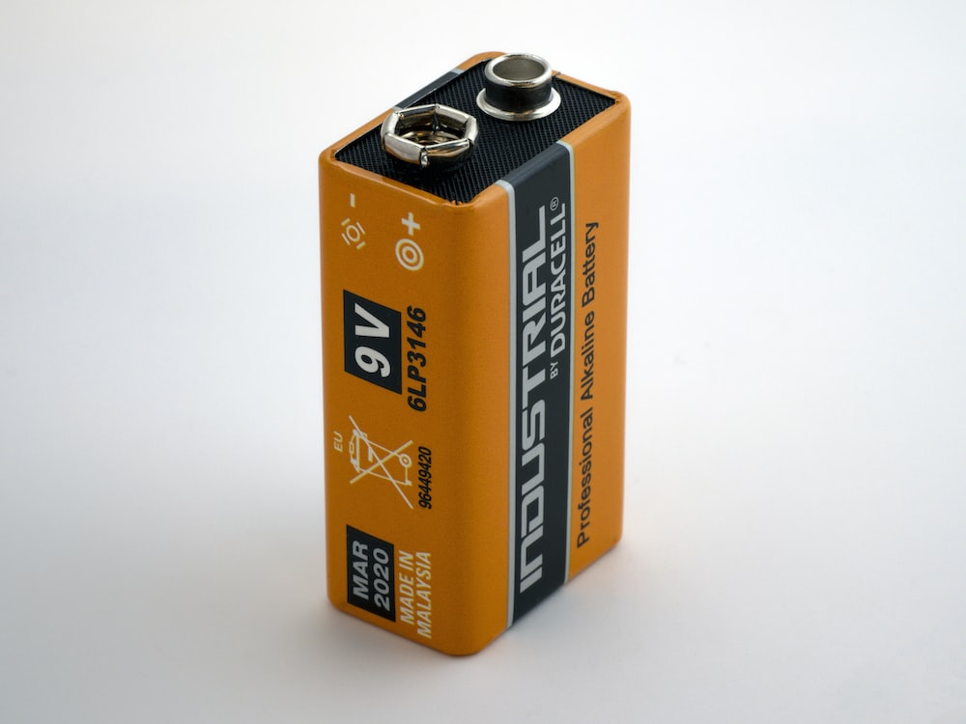
Battery
A battery can be defined as an electrochemical device.
Which can be charged with an electric current and discharged whenever required. Batteries are usually devices that are made up of multiple electrochemical cell.
That are connected to external inputs and outputs. Batteries are widely employed in order to power small electric devices as mobile phones, remots, and flashlights.

Slide 10
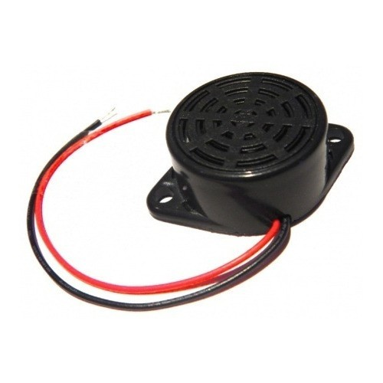
Piezo Buzzer
The buzzer is a sounding device that can convert audio signals into sound signals.
It is usually powered by DC voltage.
The piezoelectric buzzer uses the piezoelectric effect of the piezoelectric ceramics and uses the pulse current to drive the vibration of the metal plate to generate sound.

Slide 11
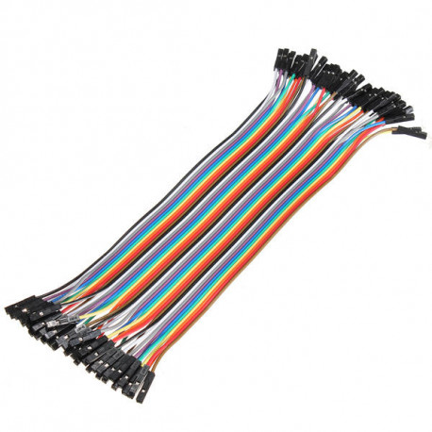
Jumper Wires
A jump wire (also known as jumper, jumper wire, DuPont wire) is an electrical wire, or group of them in a cable, with a connector or pin at each end (or sometimes without them – simply "tinned"), which is normally used to interconnect the components of a breadboard or other prototype or test circuit, internally or with other equipment or components, without soldering.

Slide 12
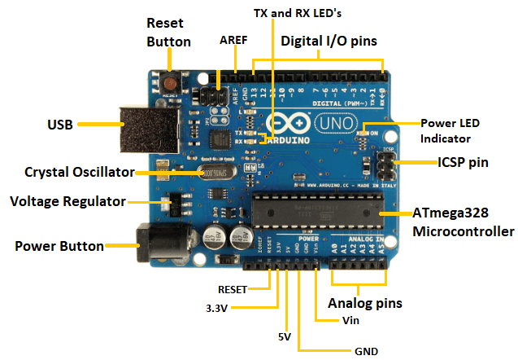
Microcontroller
The Arduino uno is an open-source ,microcontroller board based on the microchip ATmega328P microcontroller and developed by Arduino.cc.
The board has 14 digital I/O pins , via a type B USB cable.
Arduino software (IDE) includes a serial monitor which allows simple textual data to be sent to and from the board.
This board cab be directly connected to the computer through USB that transfer the code to controller using IDE.

Slide 13
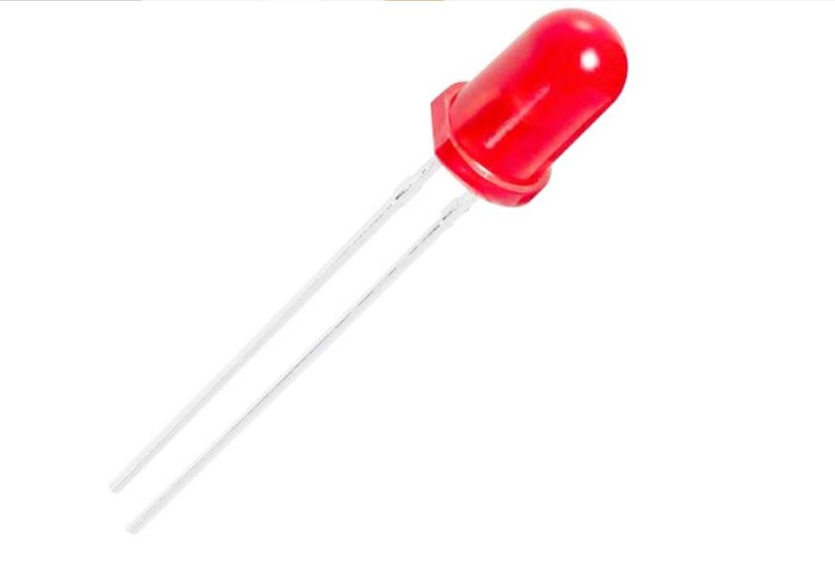
LED
LEDs are special diodes that emit light when connected in a circuit. They are frequently used as "pilot" lights in electronic appliances to indicate whether the circuit is closed or not. A clear (or often colored) epoxy case enclosed the heart of an LED, the semi-conductor chip.
LED’s must be connected the correct way round, the diagram may be labeled a or + for anode and k or - for cathode. The negative side of an LED lead is indicated in two ways:
1) By the flat side of the bulb.
2) By the shorter of the two wires extending from the LED.

Slide 14
Work Plan
The project we made is a social distancing device by seeing daily movement of a man.
Whenever a person goes too close to another person it automatically gives alarm and we maintain distancing.
Keeping all in mind we planned to work on this project to save lives and minimizing the spread of corona virus.

Slide 15
Software Required
Arduino IDE

Slide 16
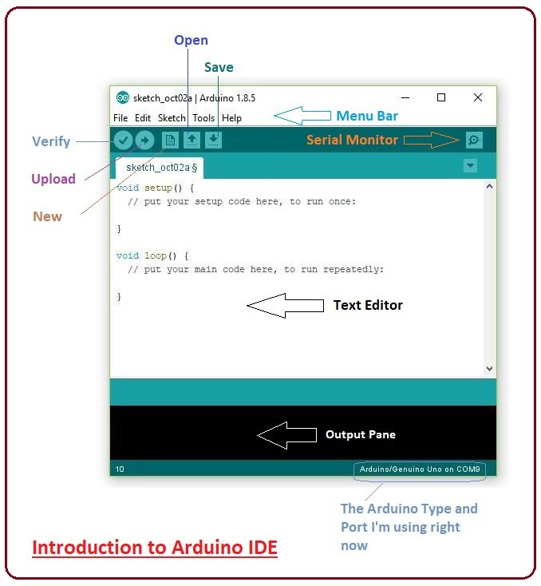
ARDUINO IDE
The Arduino integrated Development Environment(IDE) is a cross platform application that is written in functions from C and C++ .
It is used to write and upload programs to Arduino compatible boards, but also, with the help of third-party cores, other vendor development boards.

Slide 17
Programming languages used
The microcontroller Arduino uno is programmed in such a way that whenever a person comes too close to ultrasonic sensor it activates the buzzer.
Embedded C/C++

Slide 18
Applications
Stop shaking hands with others.
Avoid non-essential meetings
Hold essential meetings in the open air.
Provide alcohol-based sanitizer for all staff.
Regularly clean and disinfect surfaces used by humans.

Slide 19
Future Plan
As we know the project is made of automated system so this type of project may help the world in minimizing the spread of corona virus.
If I came to pandemic again in future, these kinds of devices could save us ans prevent us from spreading.

Slide 20
Conclusion
We tried our best to incorporate pre planned idea into our project to fulfil the required of a social distancing device.
We also observed that our model has been able to dispense its task effectively and properly.
Thus we hope our project will draw attention of many people.

Slide 21
References
[1]. Habibolah Arasteh rad & Aeshia Badi (2020). A Study on control of novel corona-virus (2019-nCov) disease process by using PID controller. MedRxiv, pp 1-19. doi: https://doi.org/10.1101/2020.04.19.20071654.
[2]. Diah Handayani, Dwi Rendra Hadi, Fathiyah Isbaniah, Erlina Burhan & Heidy Agustin (2020). Penyakit Virus Corona 2019. Jurnal Respirologi Indonesia. 40(2), pp 119-129.
[3]. Giselle Ann Alcoran Alvarez, Marc Brian Garcia & Dave Unabia Alvarez (2020). Automated Social Distancing Gate with Non-Contact Body Temperature Monitoring using Arduino Uno. International Research Journal of Engineering and Technology. 07(07), pp 4351- 4356.
[4]. David Cababaro Bueno (2020). Physical distancing: A rapid global analysis of public health strategies to minimize COVID-19 outbreaks. Institutional Multidisiplinary Research and Development Journal. 3, pp 31-53. doi: https://doi.org/10.13140/RG.2.2.30429.15840/1
[5]. Con T. Nguyen, Yuris Mulya Saputra, Nguyen Van Huynh, Ngoc-Tan Nguyen, & Trat Viet Khoa (2020). Enabling and Emerging Technologies for Social Distancing: A Comprehensive Survey. ArXiv, pp 1–42.

Slide 22


